Slide 1
C Programming
Chapter 4

Slide 2
Operators
An operator is a symbol that operates on a value or a variable. For example: + is an operator to perform addition.
C has a wide range of operators to perform various operations.

Slide 3
C Arithmetic Operators
An arithmetic operator performs mathematical operations such as addition, subtraction, multiplication, division etc on numerical values (constants and variables).

Slide 4
C Arithmetic Operators
Operator | Meaning of Operator
+ | addition or unary plus
- | subtraction or unary minus
* | multiplication
/ | division
% | remainder after division (modulo division)

Slide 5
Precedence and Associativity of Operators
Rules of associativity and precedence of operators determine precisely how expressions are operated.
In the expression 1 + 2 * 3, the operator * has higher precedence than +, causing the multiplication to be performed first.
The result is 7 instead of 9.

Slide 6
Associativity of Operators
When two operators placed in proximity in an expression have the same precedence, their associativity is used to determine how the expression is evaluated.
In the expression 6 / 2 * 3, both / and * have the same precedence. Since they both have left to right associa-tivity, the expression has the value 9 rather than 1.

Slide 7
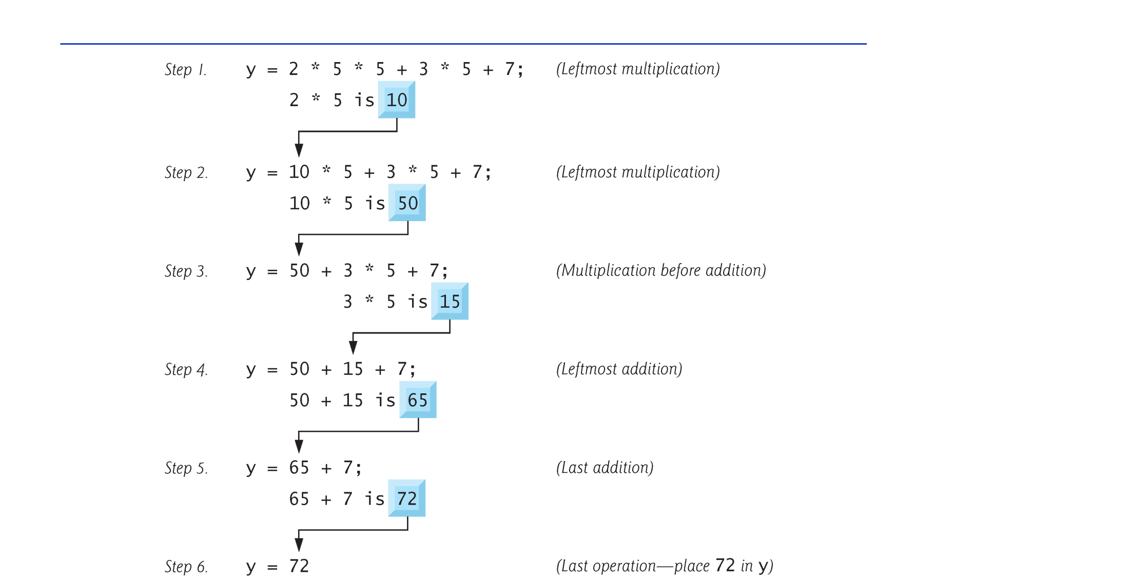

Slide 8
Parentheses and the Order of Operations
Expressions inside parentheses are evaluated first.
This provides for the use of parentheses to clarify or change the order in which operations are performed.
1 + 2 * 3 has a value of 7.
(1 + 2)* 3 has a value of 9.

Slide 9
Binary Plus versus Unary Plus
Both binary plus and unary plus are represented by a + (plus sign).
The same is true of binary and unary - (the minus sign).
Unary + and - have a higher precedence that binary + and - and the unary operators associate right-to-left instead of left-to-right.

Slide 10
Example of Unary Operators
In the expression - a * b - c the first minus is unary and the second is binary.
We can use parentheses to write an equivalent expression that is less likely to be misinterpreted.
((- a) * b) - c

Slide 11
Example of Unary Operators Using Numbers
-1 * 2 - 3 has a value of -5
it is equivalent to
((-1) * 2) - 3 or (-2) - 3
which is -5
it is not equivalent to
(-1) * (2 - 3) or (-1) * (-1)
which is +1

Slide 12
Increment and Decrement Operators
++ (the increment operator) and -- (the decrement operator) are unary operators with the same precedence and right-to-left associativity as the other unary operators.
The ++ and -- operators can occur in either a prefix or postfix position with different results.

Slide 13
Prefix versus Postfix When Using Increment and Decrement Operators
Each of the expressions ++i and i++ causes the stored value of i to be incremented by 1, however:
The expression ++i causes the stored value of i to be incremented first, with the expression then taking as its value the new stored value of i.
The expression i++ has as its value the current value of i; then the stored value is incremented.

Slide 14
Example of the Increment and Decrement Operators
int a, b, c = 0;
a = ++c;
b = c++;
printf(“%d %d %d\n”, a, b, ++c);
/* _ _ _ ? is printed */
c is incremented making its value 1.
The result assigned to a making its value 1.
The value of c is assigned to b making its value 1.
Then c is incremented making its value 2.
Finally, c is incremented before it is printed, making its value 3.

Slide 15
Practice with Operators and Expressions
Declarations and Initializations
int a = 1, b = 2, c = 3, d = 4;
Expression Equivalent expression Value
a * b / c (a * b) / c 0
a * b % c + 1 ((a * b) % c) + 1 3
++a * b - c -- ((++a) * b) - (c--) 1
7 - -b * ++d 7 - ((-b) * (++d)) 17

Slide 16
Partial Table of Operator Precedence and Associativity
Operator Associativity
() ++ (postfix) -- (postfix) left to right
+(unary) -(unary) ++(prefix) --(prefix) right to left
* / % left to right
+ - left to right
= += -= right to left
Operators on the top line have the highest precedence.
Precedence decreases line-by-line going down the table.
All operators on the same line have equal precedence.

Slide 17
Assignment Operators
C treats = as an operator.
It’s precedence is lower than almost all of the other operators.
It’s associativity is right to left.

Slide 18
Form of an Assignment Expression
A simple assignment expression is of the form variable = right_side
The value of right_side is assigned to variable, and that becomes the value of the assignment expression as a whole.

Slide 19
Assignment Expressions versus Assignment Statements
An assignment expression has no semicolon at the end.
An assignment statement does.
We can use assignment expressions to condense a sequence of assignment statements.

Slide 20
Example of Equivalent Code Using Assignment Expressions
Assignment statements
b = 2;
c = 3;
a = b + c;
Equivalent statement using assignment expressions
a = (b = 2) + (c = 3);
Note the assignment statement ends with a semicolon, the expressions don’t.

Slide 21
Other Assignment Operators
C has operators that combine assignment with other operations. These are considered assignment operators and have the same precedence and right-to-left associativity as =.
Example
k = k + 2;
is equivalent to
k += 2;

Slide 22
The Assignment Operators
= += -= *= /= %= >>= <<= &= ^= |=
The semantics of the other assignment operators is specified by
variable op= expression
which is equivalent to
variable = variable op (expression)
j *= k + 3
is equivalent to
j = j * (k + 3)
and not
j = j * k + 3

Slide 23
Preprocessor Directives
Include files (header files)
#include <filename>
Causes the preprocessor to look for filename in system defined places and replace the #include line with a copy of contents of filename.
#include “filename”
Same as above, but the preprocessor looks in the current directory before looking in the system defined directory locations.

Slide 24
Where are these “System Defined” Places?
On UNIX systems, the standard header files such as stdio.h can typically be found in the directory /usr/include.
You can use any editor to look at what is in these files.

Slide 25
Header Files Must be Included for Functions in the Standard Library
The system knows where to find the code for functions in the standard library.
However, it is the responsibility of the programmer to include the header files that provide the prototypes for library functions.

Slide 26
The Libraries versus the Header Files
The standard library contains object code (already compiled library functions).
The standard header files are text files that you can read using a text editor. They provide information needed by the library functions.

Slide 27
Style
Do not condense code just for the sake of using less space
y = 2;
z = 3;
x = y + z;
is more readable than
x = (y = 2) + (z = 3);
and
a += 7; versus a = a + 7;
is a matter of choice.

Slide 28
Common Programming Errors
Warning and Error Messages usually refer to a line number.
The problem may be prior to that line -- such as not properly closing a comment or a string constant.

Slide 29
System Considerations
ANSI C has both a unary + and a unary -
Traditional C has only unary -, so you should not use the unary + operator if you are writing code that needs to be portable to a machine that uses traditional C.
If you are writing code for a spectrum of systems, limitations of all of the systems must be respected.

